Slide 1
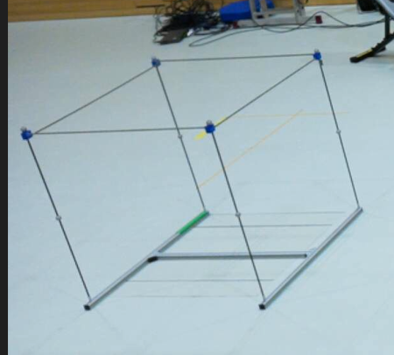
OVER THE
GREEN TAPE
0, Y, 0
X, 0, 0
X, Y, 0

Slide 2
OVER THE
GREEN TAPE
0, 0, Z
0, Y, Z
X, 0, Z
X, Y, Z

Slide 3
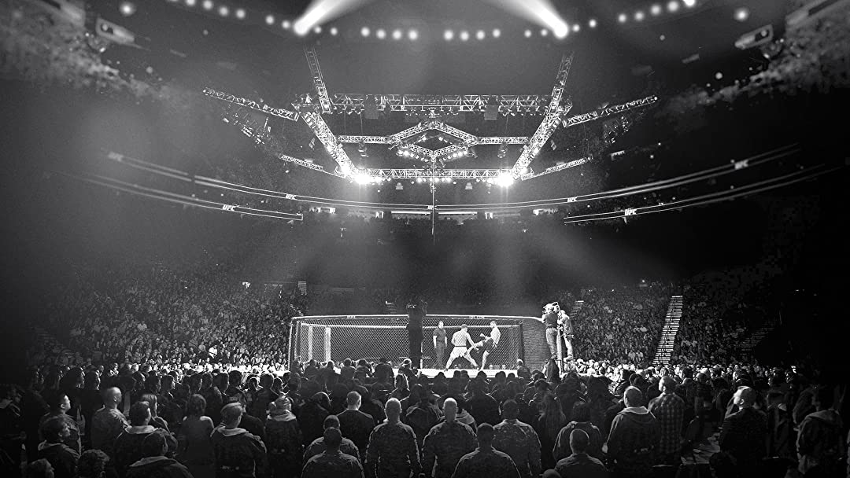
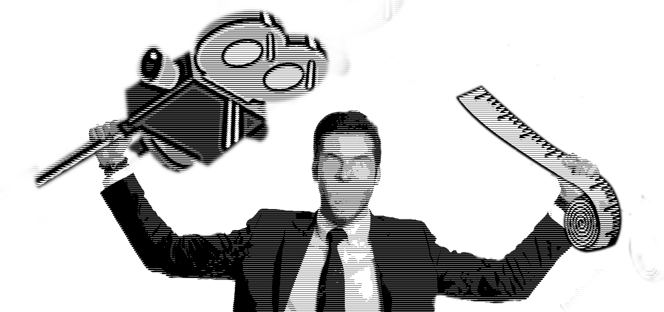

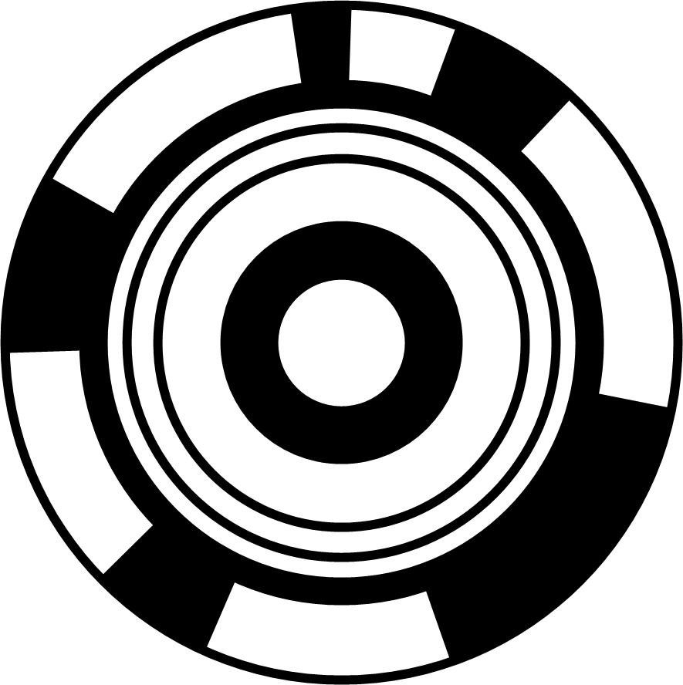
APPLICATION LOGO
egym Calibrator 1.0.0
Carlos A. Dietrich
This app is supplied "AS IS". The Contributing Authors disclaim all warranties, expressed or implied, including, without limitation, the warranties of merchantability and of fitness for any purpose. The Contributing Authors assume no liability for direct, indirect, incidental, special, exemplary, or consequential damages, which may result from the use of this app, even if advised of the possibility of such damage.

Slide 4
BACKGROUND
WELCOME TO THE CALIBRATION TOOL
(this tool is a work in progress)

Slide 5
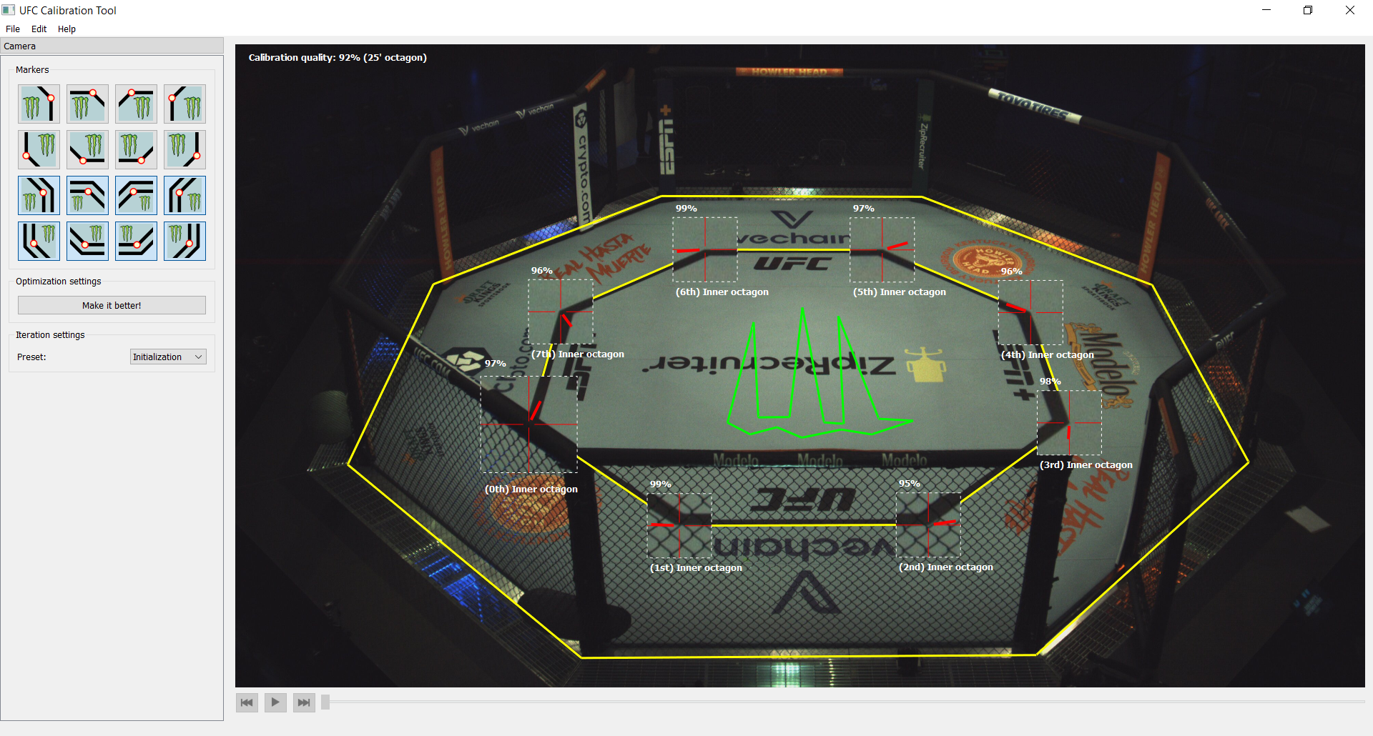
UFC Calibrator cheat sheet
The overall calibraiton quality, which should be above 90%.
The available calibration markers. The dot in the icon indicates the target position of the marker.
The calibration makers. Notice the quality (top) and the name (bottom) of each marker, which should be above 90% and correspond to the actual octagon, respectively. The red bar is a suggestion on how the marker may be moved to improve the (current) calibration.
The trigger of the calibration improvement. Click as many times as you want, and every time a marker position is changed
The two calibration modes, one to align the layout to the scene (“initialization”), one to refine the alignment (“refinement”)
The octagon layout, which should be aligned to the scene (especially the inner octagon), and with the main logo oriented in the same way as the actual logo in the arena.
(you can close this window by clicking on top of it)

Slide 6
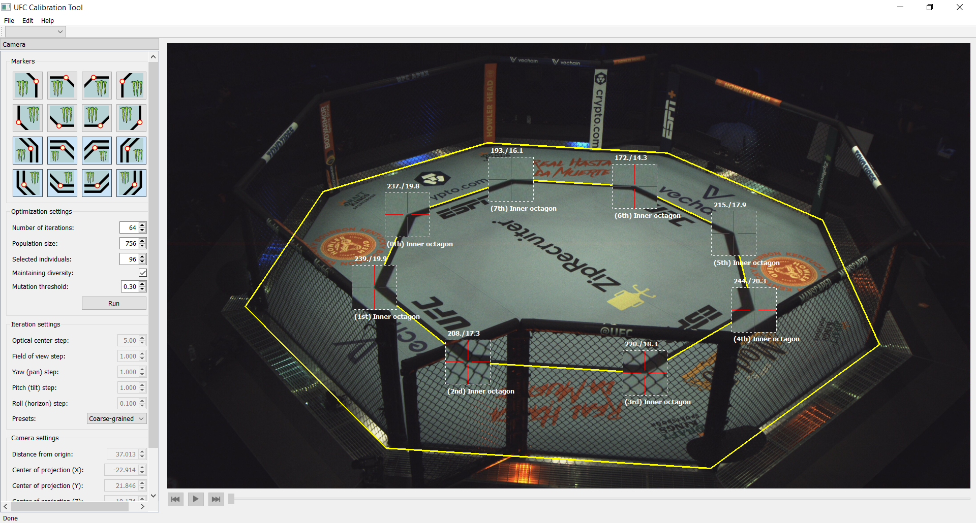
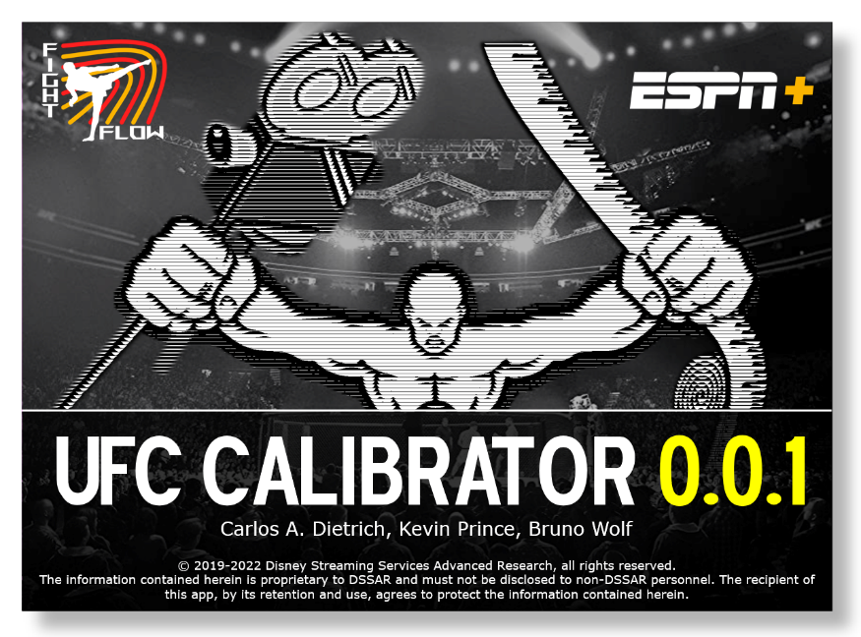

Slide 7
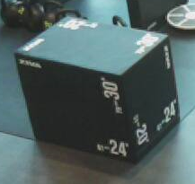
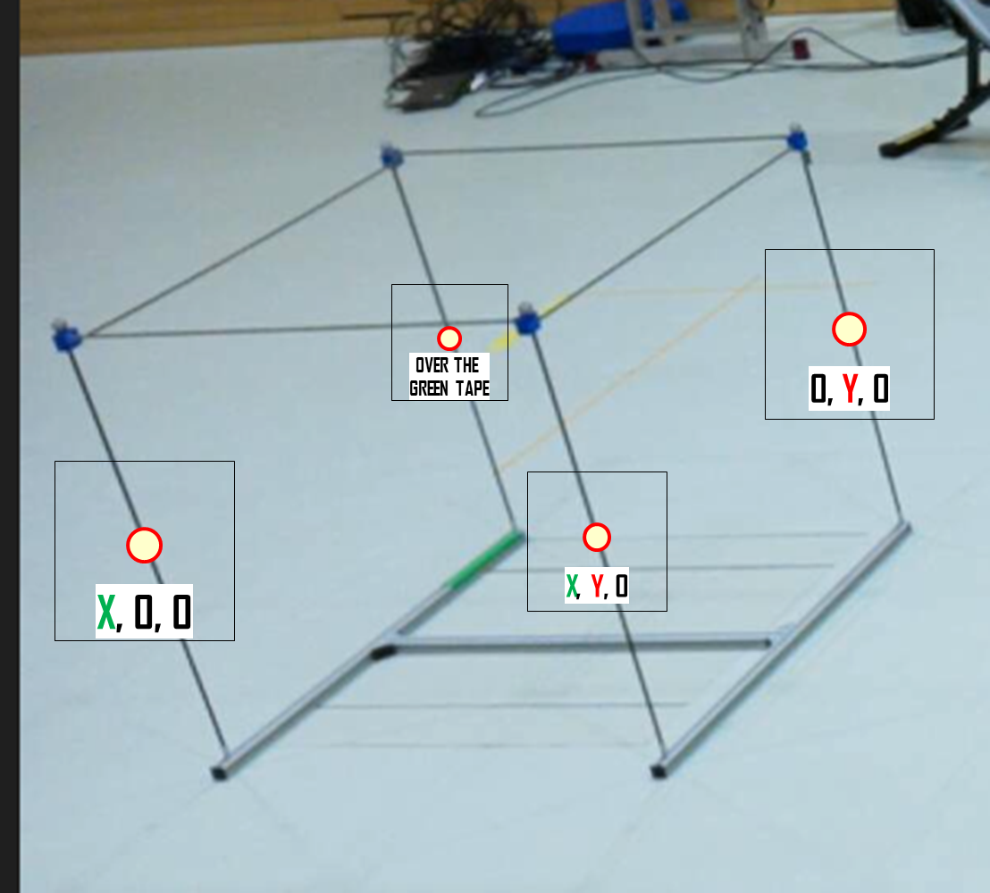
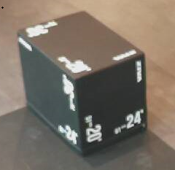
OVER THE
GREEN TAPE
0, 0, Z
0, Y, Z
X, 0, Z
X, Y, Z
0, Y, 0
X, 0, 0
X, Y, 0
X, Y, Z
0, Y, Z
OVER THE
GREEN TAPE
X, 0, Z
0, 0, Z
0, Y, 0
X, 0, 0
OVER THE
GREEN TAPE

Slide 8


